Slide 1

Stock Price Prediction using LSTM
Predicting Microsoft Stock Prices with Deep Learning
Submitted By Shati Biswas

Slide 2

Problem Statement
Predict future stock closing prices of Microsoft
Goal
Aid investors in making informed financial decisions using machine learning

Slide 3
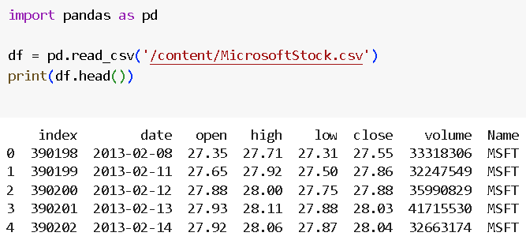
Dataset Overview
Total Records: 1,259
Date Range: Starts from 2013-02-08 (based on first row )
:Microsoft Corporation (MSFT)

Slide 4




Data Preprocessing
Data Insights
Data normalization
Created sequences of
100-day windows
No missing values found
Focused on 'Close' price
80/20 train-test split
Applied MinMaxScaler for normalization
time_step = 100

Slide 5

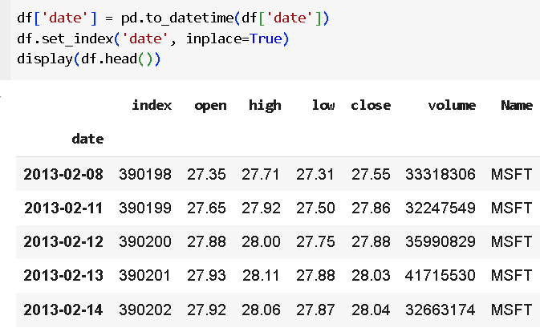
Data Preprocessing:
Convert the date column into DateTime format and set it as an index.

Slide 6
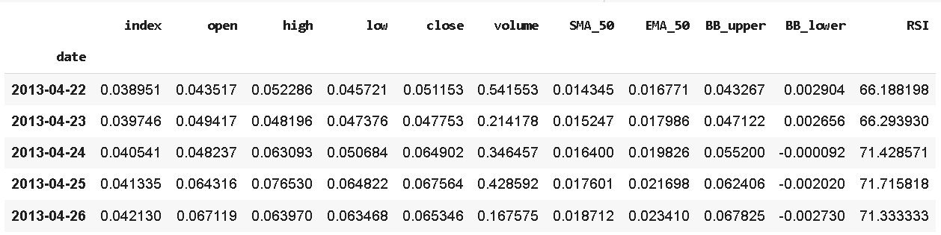
Create additional features like:
o Moving Averages (SMA, EMA)
o Bollinger Bands
o RSI (Relative Strength Index)

Slide 7
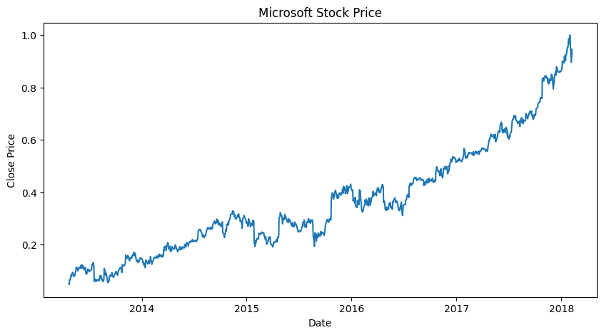
Exploratory Data Analysis (EDA)
VISUALIZATION

Slide 8
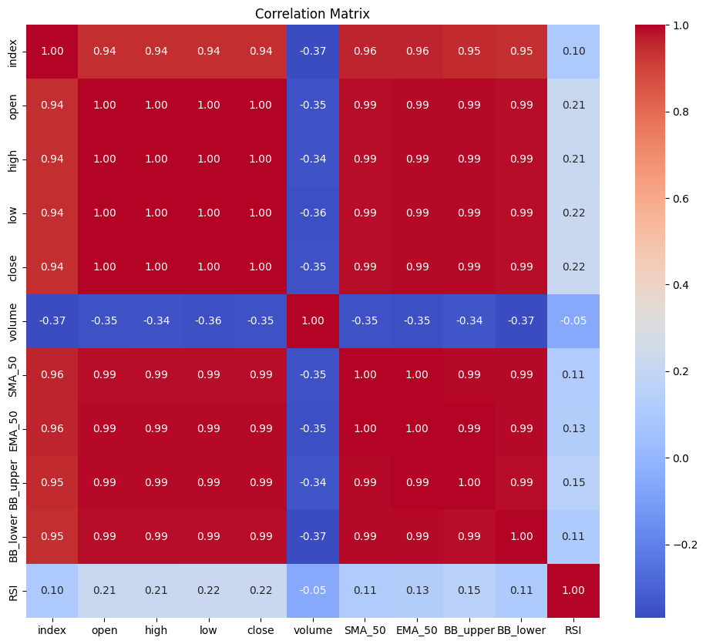
Exploratory Data Analysis (EDA)
VISUALIZATION

Slide 9
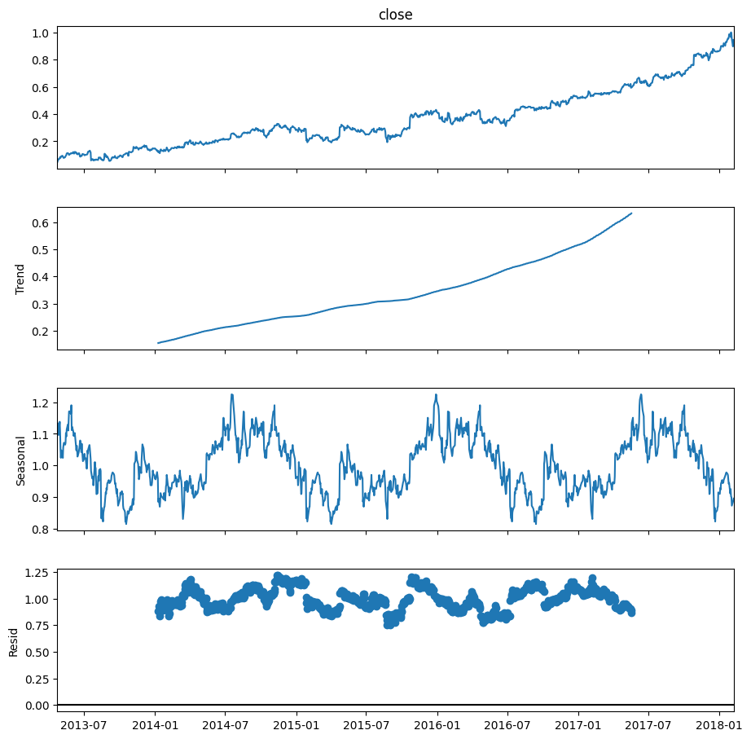
SEASONAL
DECOMPOSE

Slide 10
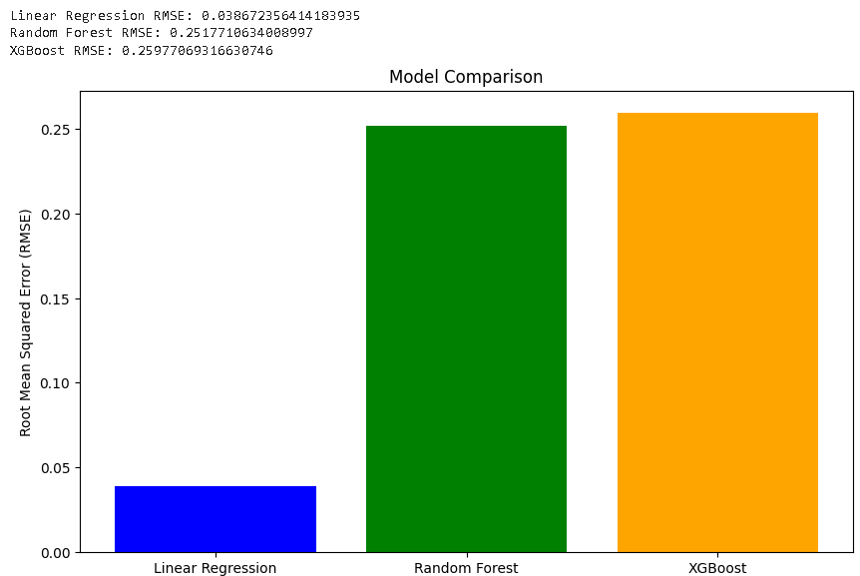
Model training & Evaluation using ML Algo

Slide 11
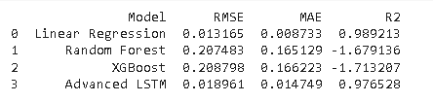
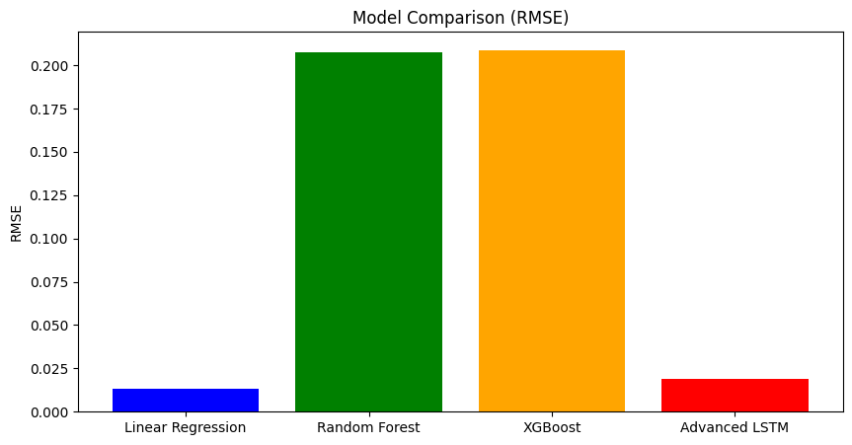
Use LSTM (Deep Learning Model) for accurate time series forecasting.

Slide 12
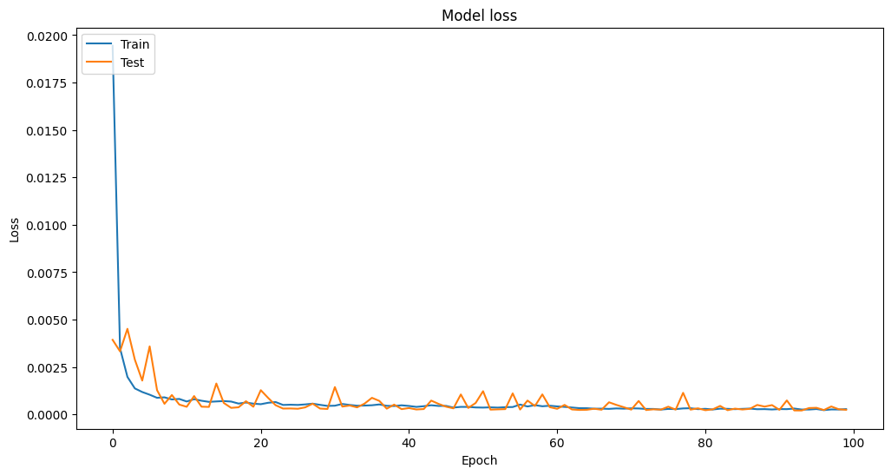
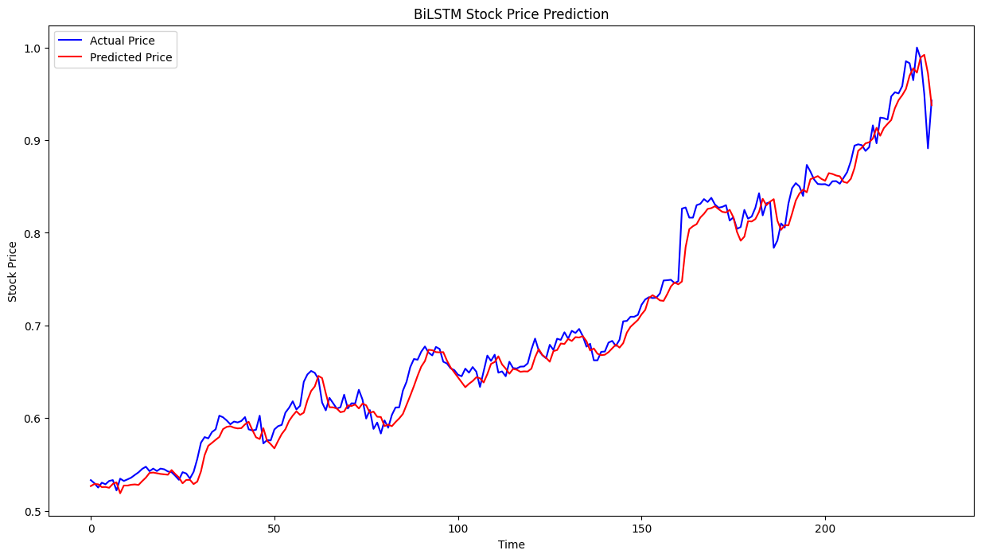
Using Advanced
BiLSTM Model and result
analysis:
Results
Predicted prices closely follow actual prices
Graph analysis shows strong trend prediction
Model captures direction and pattern effectively

Slide 13
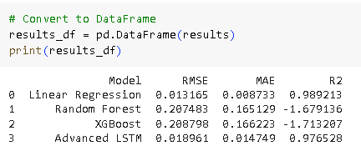
Comparative model Analysis:

Slide 14
Challenges
High volatility in stock prices
External factors (e.g., news, economy) not included

Slide 15
Conclusion
LSTM shows promise in time series prediction for stock prices.
This project proves the applicability of deep learning in financial forecasting.
With further improvements, it can assist in portfolio planning and investment strategies

Slide 16

Thank You!

